Slide 1
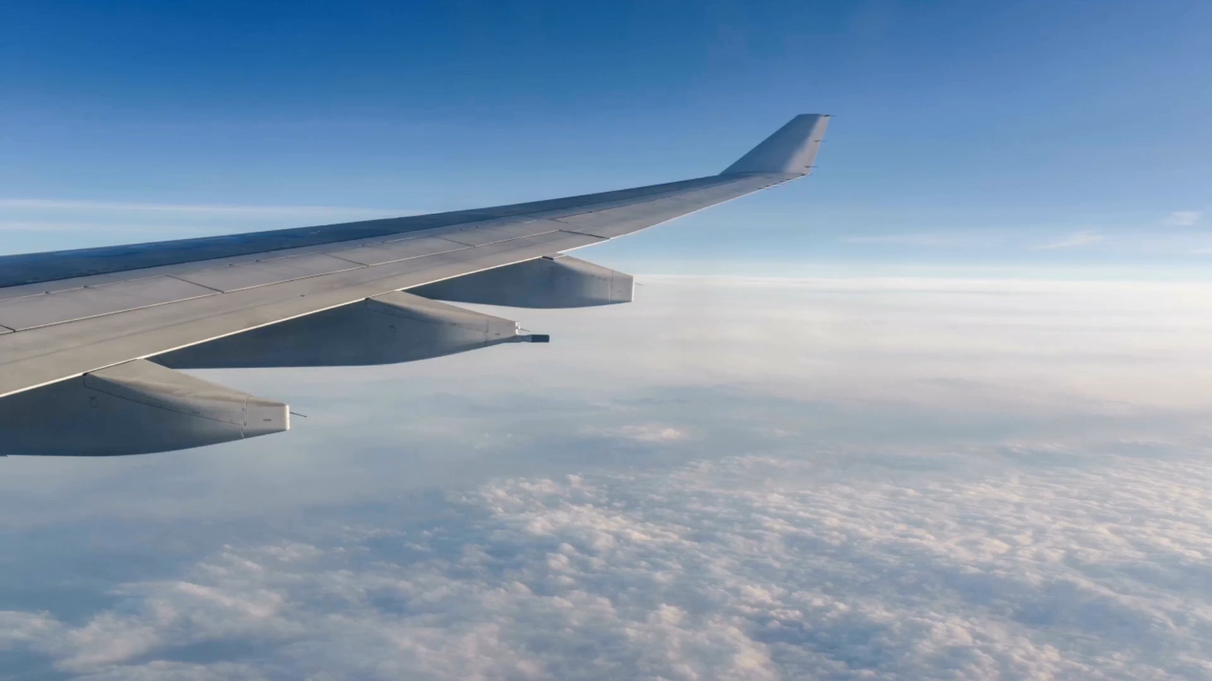
Above the clouds – Journey of safety and Resilience
Venkat Radhakrishnan
DSC 640

Slide 2

Meet Sarah
A seasoned traveler with a passion for exploring the world.
Apprehensive amidst swirling media reports of airline safety concerns.

Slide 3
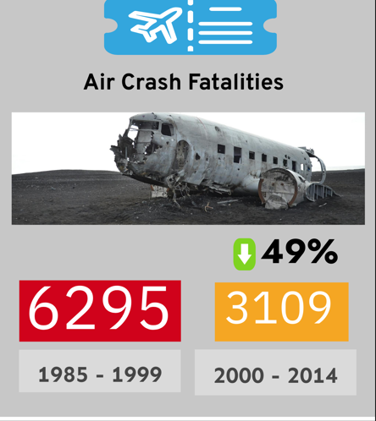
Airline Safety over the years

Slide 4
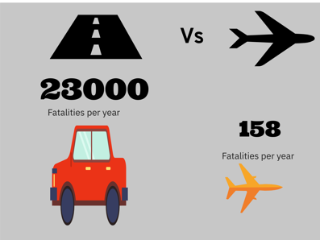
Road vs Air Travel

Slide 5
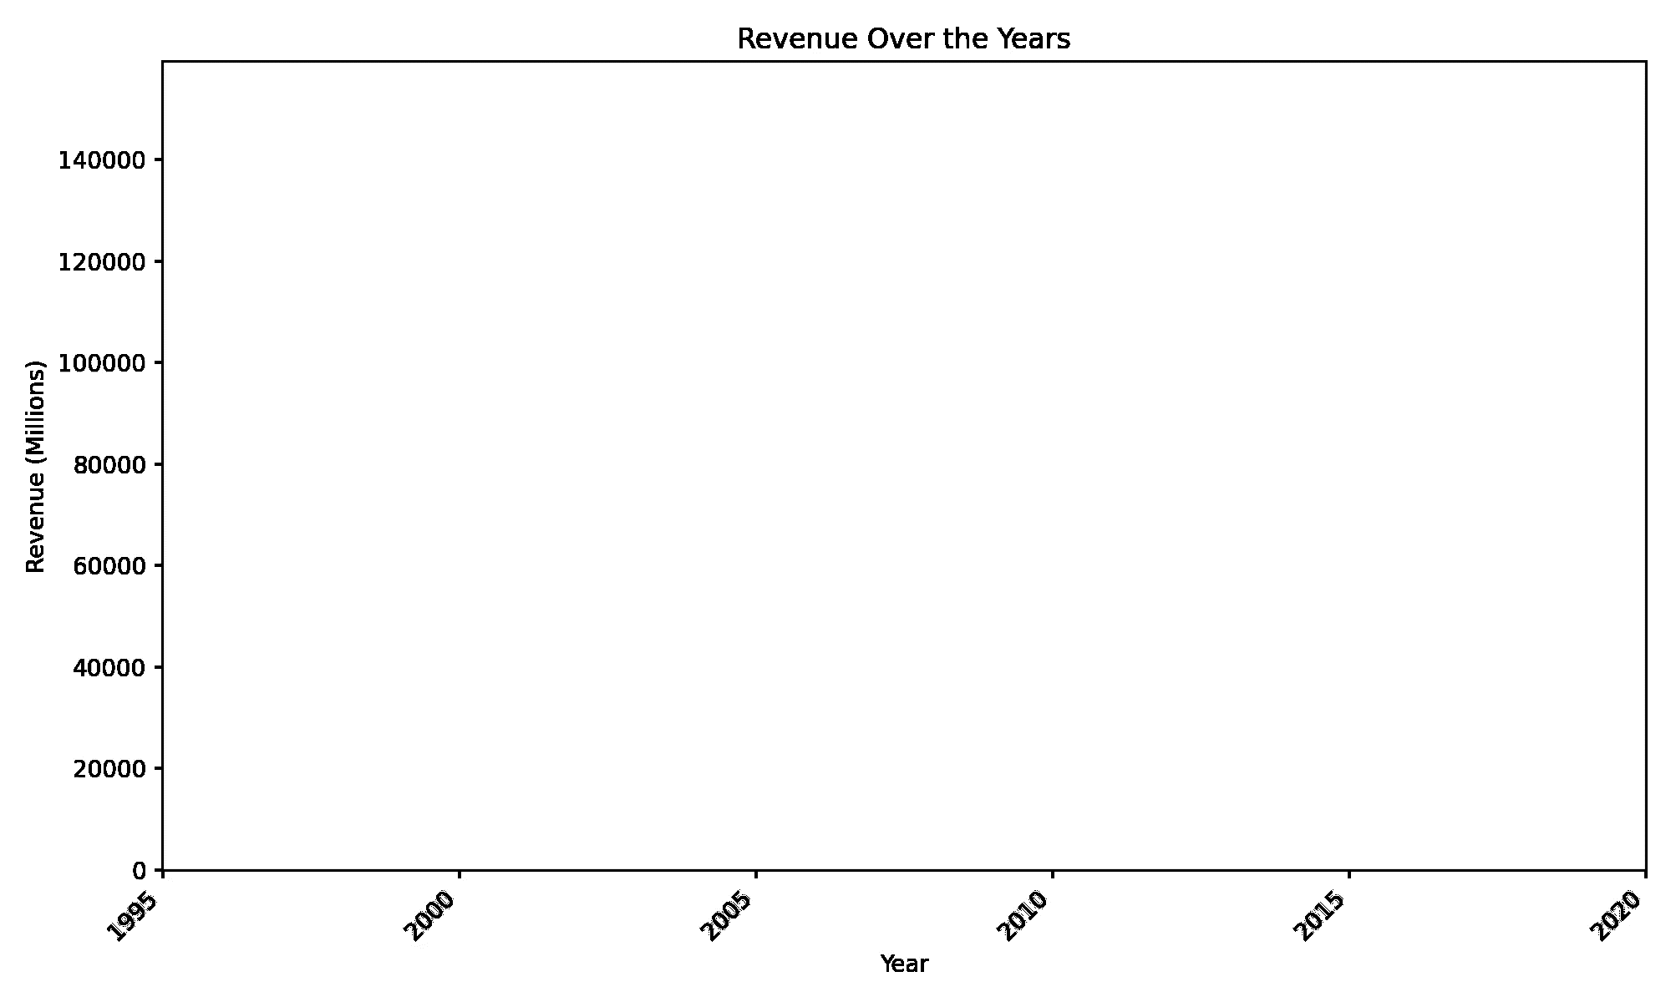
Safety and Revenue Correlation

Slide 6
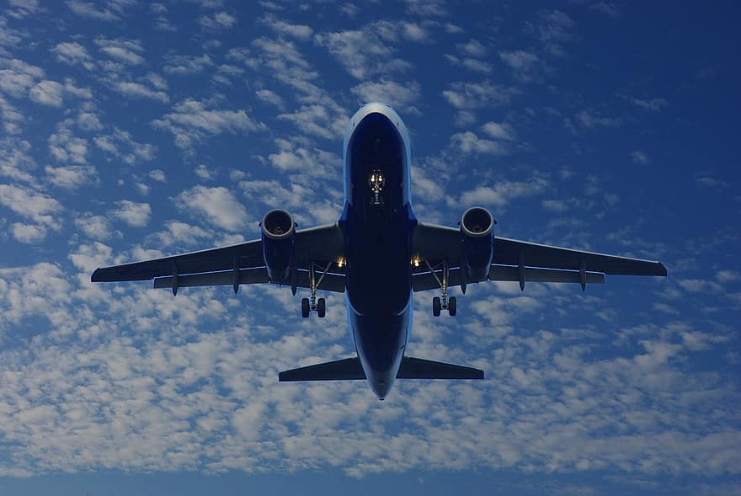
Conclusion
Airline safety continues to inspire and reassure Passengers.

